Slide 1


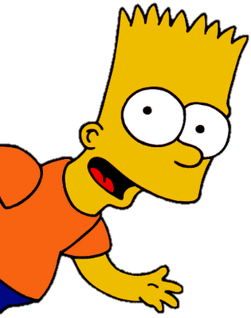
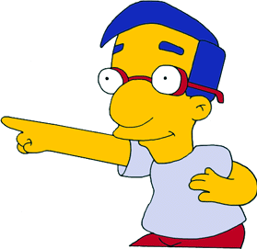
PRESENT SIMPLE
by HERBER

Slide 2
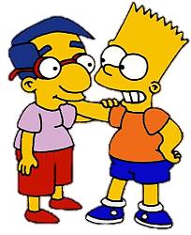
AFFIRMATIVE
I have got a
good friend.

Slide 3
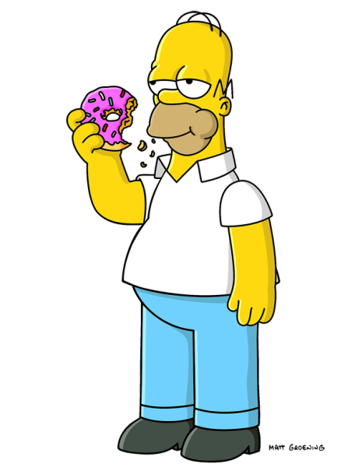
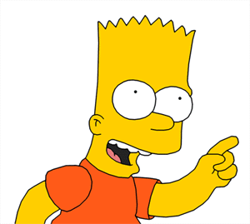
AFFIRMATIVE
Dad, you have got a doughnut.

Slide 4
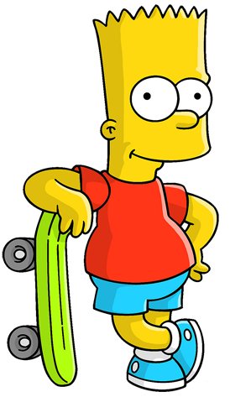
AFFIRMATIVE
He has got a skateboard.

Slide 5
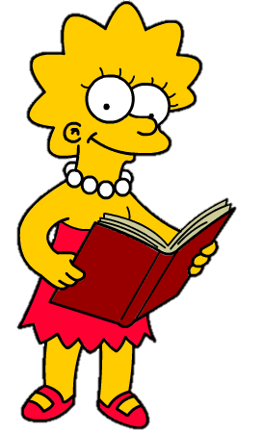
AFFIRMATIVE
She has got a book.

Slide 6
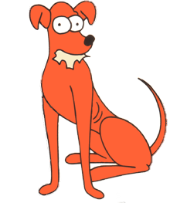
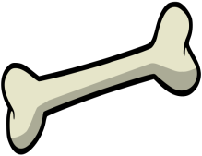
AFFIRMATIVE
It has got a bone.

Slide 7

AFFIRMATIVE
We have got a football.

Slide 8
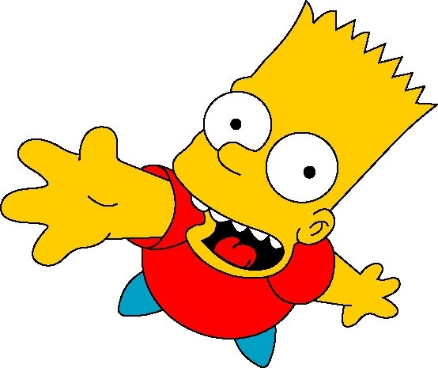
AFFIRMATIVE
You and your friends have got a good English teacher.

Slide 9
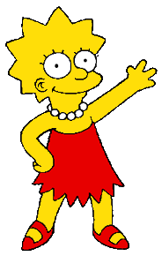
AFFIRMATIVE
They have got a football.

Slide 10
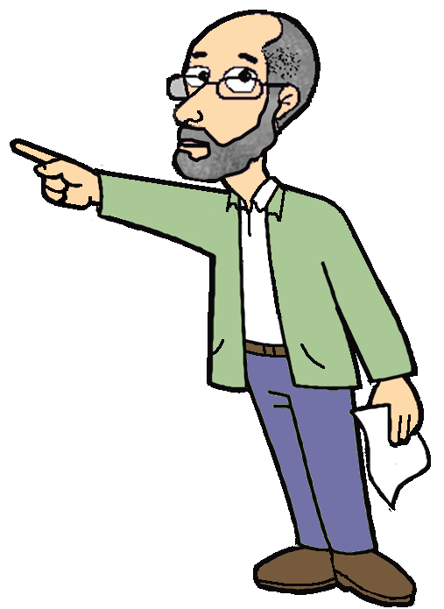
AFFIRMATIVE
I have got
I’ve got
Remember
You have got
You’ve got
He has got
He’s got
She has got
She’s got
It’s got
It has got
We have got
We’ve got
You have got
You’ve got
They have got
They’ve got

Slide 11
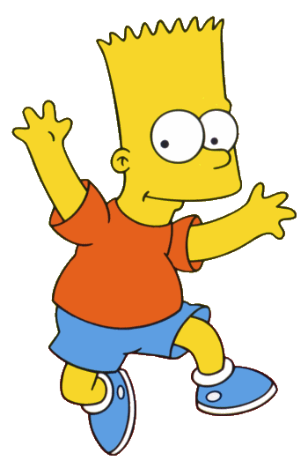
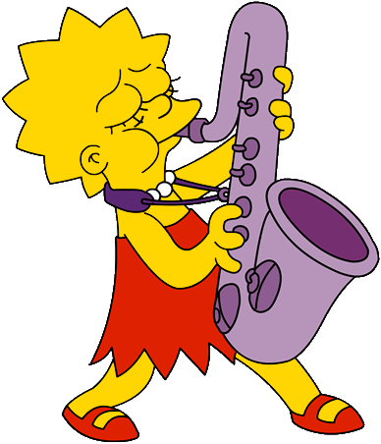
NEGATIVE
I haven’t got
a saxophone.

Slide 12
NEGATIVE
Lisa, you haven’t got a skateboard.

Slide 13
NEGATIVE
He hasn’t got a saxophone.

Slide 14
NEGATIVE
She hasn’t got a skateboard.

Slide 15
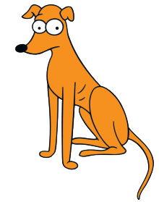
NEGATIVE
It hasn’t got a bone.

Slide 16
NEGATIVE
We haven’t got a basketball.

Slide 17
NEGATIVE
You and your friends haven’t got two noses.

Slide 18
AFFIRMATIVE
They haven’t got a basketball.

Slide 19
NEGATIVE
Remember
I have not
got
I haven’t got
not
You have not got
You haven’t got
He has not got
He hasn’t got
She has not got
She hasn’t got
It hasn’t got
It has not got
We have not got
We haven’t got
You have not got
You haven’t got
They have not got
They haven’t got

Slide 20
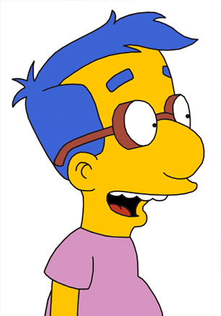
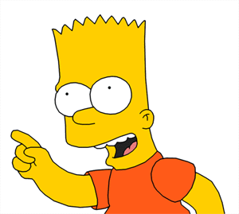
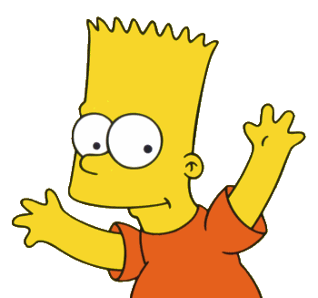
INTERROGATIVE
Have I got homework today?
Yes, you have.

Slide 21
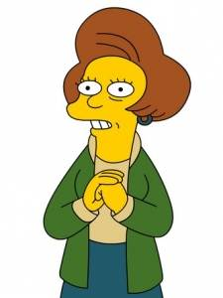
INTERROGATIVE
Have you got a skateboard?
No, I haven’t.

Slide 22
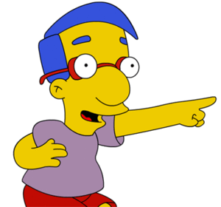
INTERROGATIVE
Has she got a ball?
No, she hasn’t.

Slide 23
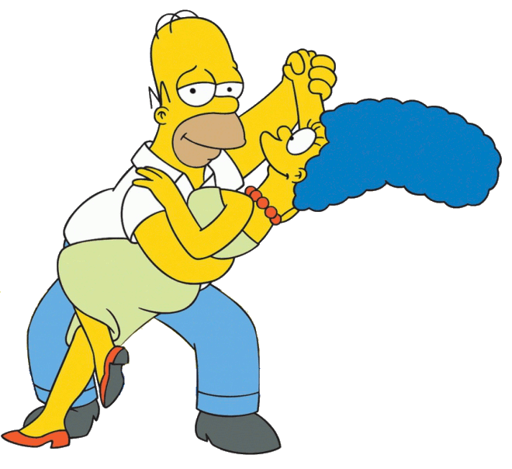
INTERROGATIVE
Have they got a saxophone?
No, they haven’t.

Slide 24
INTERROGATIVE
QUESTIONS
SHORT ANSWERS
I
Have I got?
have
got
?
Yes, I/you have
No, I/you haven’t
you
Have you got?
have
got
?
He
Remember
Has he got?
has
got
?
Yes, he/she/it has
No, he/she/it hasn’t
She
Has she got?
has
got
?
It
has
got
Has it got?
?
We
Have we got?
have
got
?
Yes, we/you/they have
No, we/you/they haven’t
you
Have you got?
have
got
?
They
Have they got?
have
got
?

Slide 25
BYE BYE!

